Slide 1
Module 7 Failure Recovery and Fault Tolerance

Slide 2
Basic concept
In any distributed system, three kinds of problems can occur.
Faults
Errors(System enters into an unexpected state) 3)Failures
All these are inter related. ...
Failure Occurs when a server does not receive incoming requests from client or fails to send messages in response to clients request.

Slide 3
Basic Concept
Fault tolerance refers to the ability of a system (computer, network, cloud cluster, etc.) to continue operating without interruption when one or more of its components fail.
Fault-tolerant systems use backup components that automatically take the place of failed components, ensuring no loss of service.

Slide 4
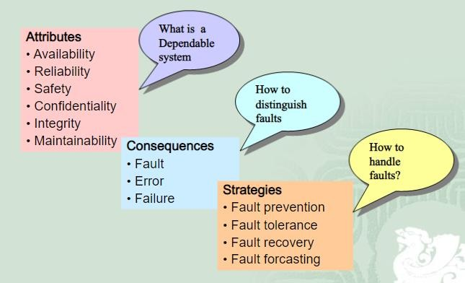

Slide 5
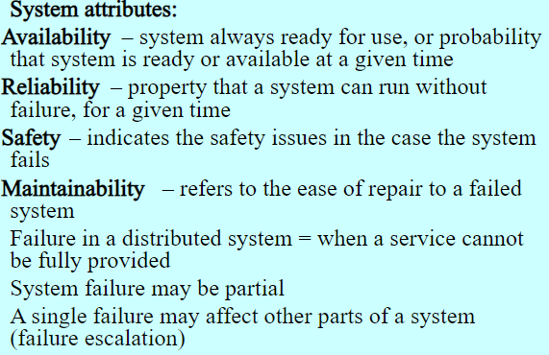

Slide 6
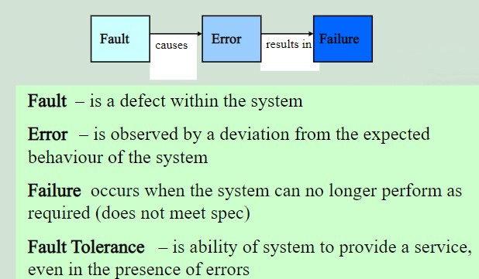

Slide 7
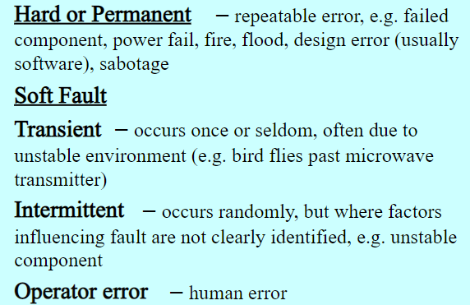

Slide 8
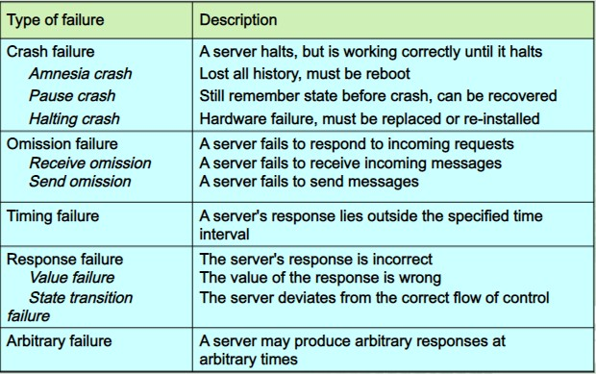

Slide 9
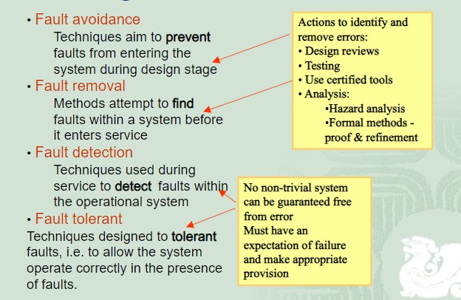
Strategies to handle faults

Slide 10
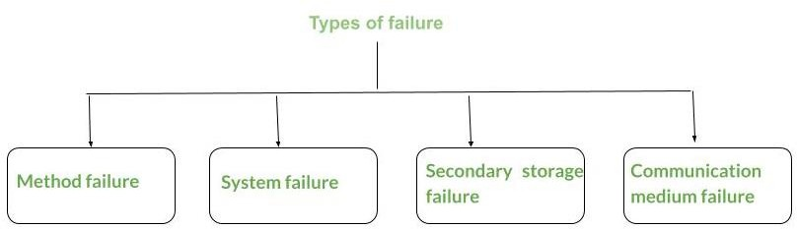
Type of Failures

Slide 11
Method failure
In this type of failure, the distributed system is generally halted and unable to perform the execution.
Sometimes it leads to ending up the execution resulting in an associate incorrect outcome.
Method failure causes the system state to deviate from specifications, and also method might fail to progress.

Slide 12
Method failure
Behavior
–
It may be
understood as if
incorrect violation,
computation deadlocks, performed execution.
Recovery –
like timeout,
Protection
user input,
etc is its
then the method stops
Method failure can be prevented by aborting the method or restarting it from its prior state.

Slide 13
System Failure
In system failure, the processor associated with the distributed system fails to perform the execution. This is caused by computer code errors and hardware issues. Hardware issues may involve CPU/memory/bus failure. This is assumed that whenever the system stops its execution due to some fault then the interior state is lost.

Slide 14
System Failure
Behavior –
It is concerned with physical and logical units of the processor. The system may freeze, reboot and also it does not perform any functioning leading it to go in an idle state.
Recovery –
This can be cured by rebooting the system as soon as possible and configuring the failure point and wrong state.

Slide 15
Secondary Storage device failure
A storage device failure is claimed to have occurred once the keep information can’t be accessed. This failure is sometimes caused by parity error, head crash, or dirt particles settled on the medium.

Slide 16
Secondary Storage device failure
Behavior –
Stored information can’t be accessed.
Recovery/Design strategies –
Reconstruct content from the archive and the log of activities and style reflected disk system. A system failure will additionally be classified as follows.
Associate cognitive state failure
A partial cognitive state failure
a disruption failure
A halting failure

Slide 17
Communication Medium Failure
A communication medium failure happens once a web site cannot communicate with another operational site within the network. it’s typically caused by the failure of the shift nodes and/or the links of the human activity system.

Slide 18
Communication Medium Failure
Behavior –
A web site cannot communicate with another operational site.
Errors/Faults –
Failure of shift nodes or communication links.
Recovery/Design strategies –
Reroute, error-resistant communication protocols.

Slide 19
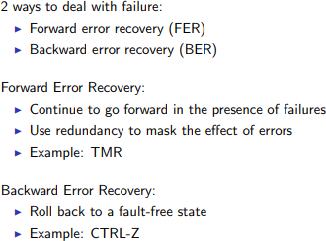
Methods to deal with failure

Slide 20
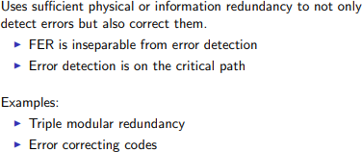
Forward Error Recovery

Slide 21
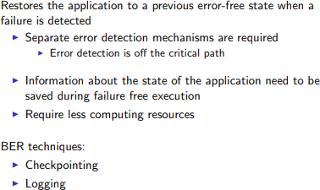
Backward Error Recovery

Slide 22
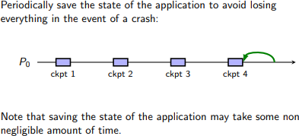
Checkpointing

Slide 23
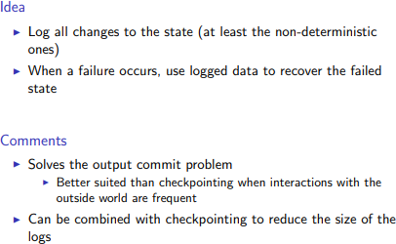
Logging

Slide 24
1.The operation –based approach 2. state-based approach
APPROACHS

Slide 25
methods: updating-in-place do undo redo display based on log records write-ahead-log protocol update an object only after the undo is recorded before committing the updates, redo and undo logs recorded.
The operation based approach

Slide 26
shadow pages: 1. a special case of the state-based recovery approach is the technique based on shadow pages. 2. Under this technique only a part of the saved to facilitate recovery 3. whenever a process wants to modify on object ,the page containing the object is duplicated and is maintained on stable storage. 4. The other unmodified copy is known as the shadow page
State-based approach

Slide 27
Commit protocols
In distributed data base and
transaction systems a distributed commit protocol is required to ensure that the effects of a distributed transaction are atomic, that is, either all the effects of the transaction persist or none persist, whether or not failures occur.

Slide 28
One phase commit protocol
A one-phase commit protocol involves a coordinator periodically communicating with the servers that are carrying out each individual transaction in order to inform them whether to commit the transaction or abort it.

Slide 29
Two phase commit protocol
The two phase commit protocol is
a distributed algorithm which lets all sites in a distributed system agree
to commit a transaction. The protocol results in either all nodes committing
the transaction or aborting, even in the case of site failures and message losses

Slide 30
Two phase commit protocol
one process acts as coordinator
other processes are called cohorts
stable storage is available at each site
each site uses write-ahead log protocol, to achieve local fault recovery and rollback
Phase-I. At the coordinator
1.the coordinator sends a COMMIT-REQUEST message to every cohort requesting the cohorts to commit
2.the coordinator waits for replies from all the cohorts.
At cohorts:
on receving the CO,,IT-REQUEST message,a cohorts takes the following actions
if the transaction excuting at the cohort is successful,it writs UNDO and REDO log on the stable storage and sends an AGREED message to the ccordinator.
Otherwise ,it sends an ABORT message to the coordinator

Slide 31
Two phase commit protocol
Phase II At the coordinator
1.If all the cohorts reply AGREED and the coordinator also agrees,then the coordinator writes a COMMIT record into the log.Then it sends a COMMIT message to all the cohorts,otherwise ,the coordinators sends an ABORT message to all the cohorts.
2.The coordinator then waits for acknowledgements from each cohort.
3.If an acknowledgement is not recived from any cohort within a timeout period,the coordinator resends the COMMIT/ABORT mmesage to the cohort.
4.If all the acknowledgements are recievd,the coordinator writes a COMPLETE record to the log (to indicate the completion of the transaction)
At cohorts:
1.On receiving a COMMIT message,a cohort releases all the resources and locks held by it for excuting the transaction,and sends an acknowledgement.
2.On receiving an ABORT message,a cohort undoes the transaction using the UNDO log record,releases all the resources and locks held by it for performing the transaction ,and sends an acknowledgement.

Slide 32
limitations
Biggest drawback is that it is a blocking protocol
Whenever the coordinator fails, cohort sites will have to wait for its recovery
This is undesirable as these sites may be holding locks on the resource.

